Slide 1

Notes:
In true SDP fashion, as team 8 our name of course had to be some kind of pun on the number 8 is it’s resemblance to infinity.

Slide 2
(SDP aw Yeeee)
Notes:
In true SDP fashion, as team 8 our name of course had to be some kind of pun on the number 8 is it’s resemblance to infinity.

Slide 3

Aims of this Presentation
Introduce you to the robots and the backend system.
Show the different stages of evolution.
Take you through the high points of the project.
4. Give some insight into why we worked well as a team.
Notes:
First of all, I’ll take you through some of the high points of the project for out team. Then I’m going to show you some of the iterations we underwent throughout the SDP process and how the system evolved from commit 1, to commit 554 (change as necceary).
Then I’m going to give you an insight into how and why we worked so well together as a team.

Slide 4
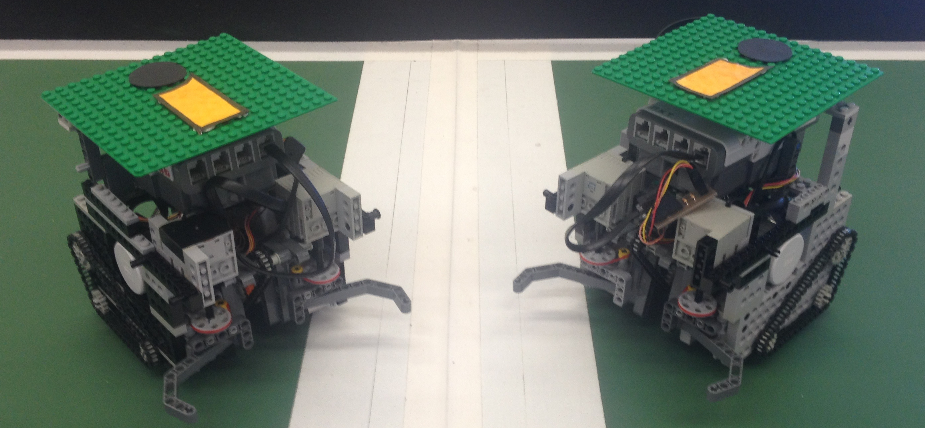
The Robots

Slide 5
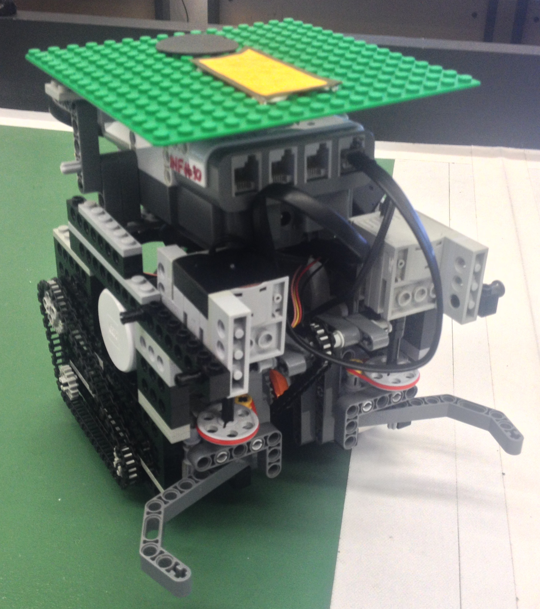
The Robots
Lego Mindstorm NXT Bricks.
Powerful chain kicker.
Ball grabber, powered by 9v motors.
TCP Bluetooth connection to vision system.
Notes:
Probably aim slide at what is unique about our robots in comparision to the other teams.

Slide 6
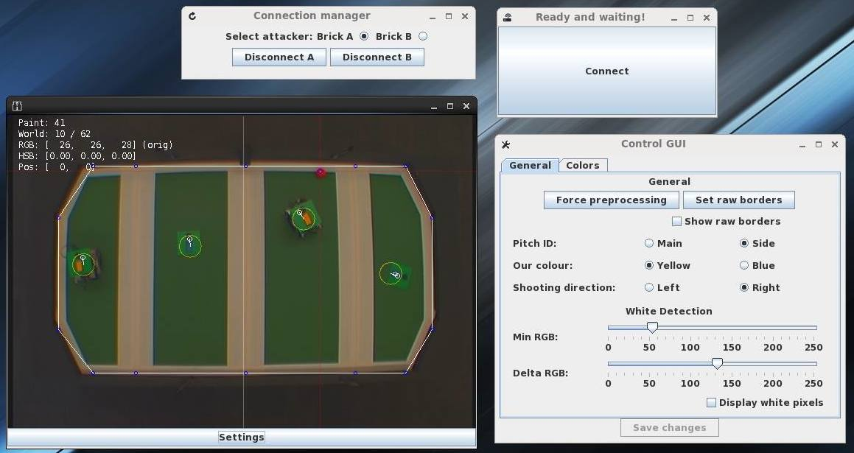
The Vision System
We designed a functional GUI to streamline the process of connecting to the robots and running the vision system.
With a setting window to fine-tune colour detection on the fly.
We integrated the GUI with the Bluetooth connection.

Slide 7
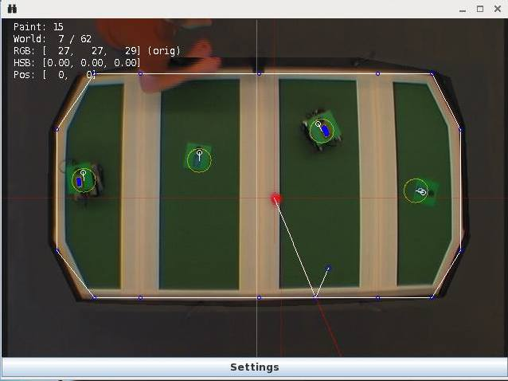
Features of the vision system
Automatically determines pitch boundaries to optimize processing.
Separate Threads to update world state and draw the state.
Ball rebound prediction.
K-Means plate detection
Distance-to-camera distortion correction.
Normalization to account for lighting changes.
Notes:
The Convex Hull code cuts out everything in the image we don’t need to look at, optimizing the vision processing, also calculates the section boundary points.
By updating at 62x/s and only drawing at 15x/s we further speed up the system.
The Vision can predict where the ball is going to be after a rebound so the robots can defend against attacks effectively even with sneaky attack methods.
System uses a fast K-means method to accurately determine green plates against a a green pitch and ignores rogue outliers.

Slide 8
Evolution of the project
Notes:
First of all, I’ll take you through some of the high points of the project for out team. Then I’m going to show you some of the iterations we underwent throughout the SDP process and how the system evolved from commit 1, to commit 554 (change as necceary).
Then I’m going to give you an insight into how and why we worked so well together as a team.

Slide 9
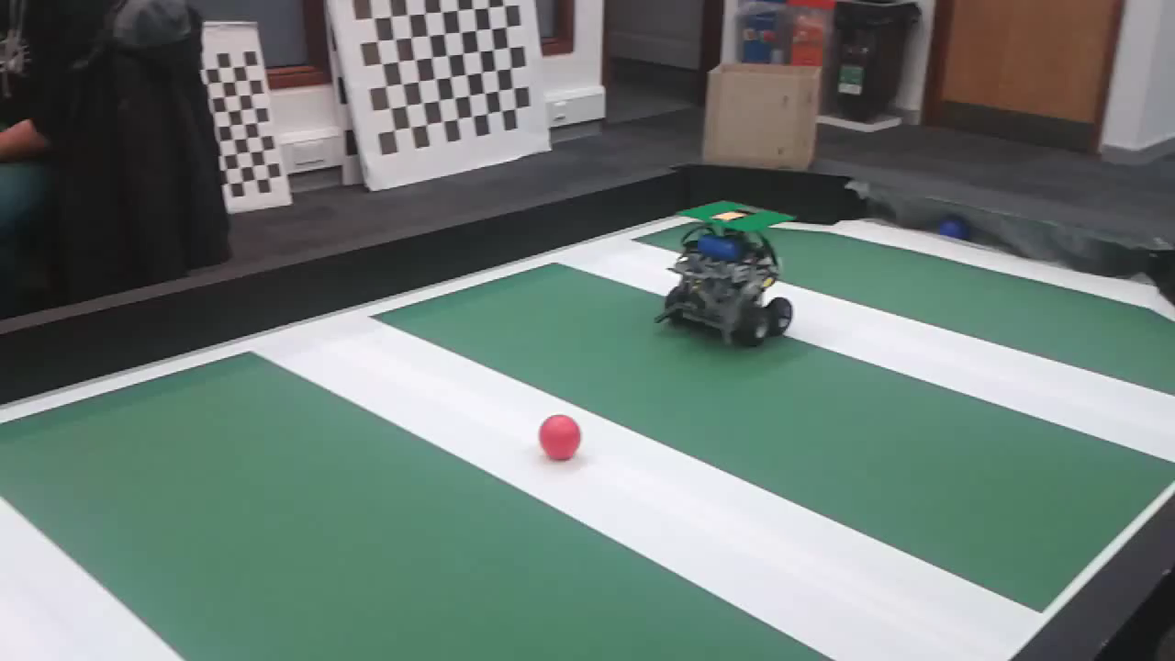
Pneumatic Kicker Design
Our initial design for kickers were effective but showed we needed to catch the ball in order to line up shots & passes.
Notes:
This was for milestone 2,

Slide 10
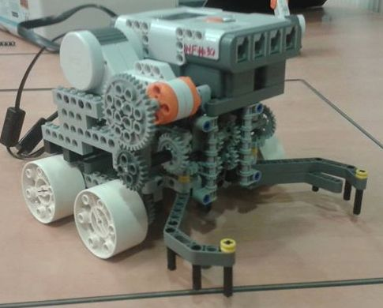
First Grabber (Beetle Design)
First design that used a ‘grabber’ so that the robots could dribble with the ball.
Able to now line up shots and passes more accurately without losing the ball.
However, the gearing system reduced the power of the kick significantly so this was a temporary design.

Slide 11
Second Grabber (Multiplexers)
First design that used a ‘grabber’ so that the robots could dribble with the ball.
Able to now line up shots and passes more accurately without losing the ball.
However, the gearing system reduced the power of the kick significantly so this was a temporary design.

Slide 12
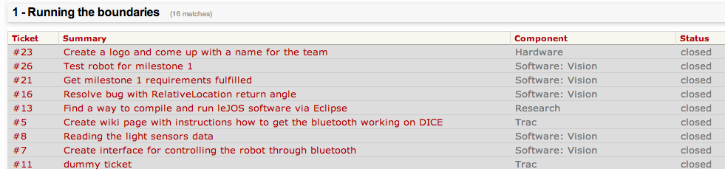
Project Management
Our greatest resource was the Trac system, running on one of our personal servers.
It allowed for the creation and allocation of tasks throughout the project and helped the team stay on ‘Trac’ while being aware of what everyone else was working on.
It was the central hub for our team with team members creating guides on setting up the system, everything you needed to have installed, coding standards for the project and tips to streamline coding & testing.
…

Slide 13
High Points
Notes:
First of all, I’ll take you through some of the high points of the project for out team. Then I’m going to show you some of the iterations we underwent throughout the SDP process and how the system evolved from commit 1, to commit 554 (change as necceary).
Then I’m going to give you an insight into how and why we worked so well together as a team.

Slide 14
Problems overcame by the team.

